Slide 1


Slide 2
Welcome To First Christian Church July 4th ^{Gayle Flanery} ^{“Worship: Glory, Beauty, Holy”}
GREETINGS
&
ANNOUNCEMENTS

Slide 3


Slide 4
^{Brad Gee} ^{Call To} ^{Worship}
We come here shouting, our voices lifted in
praise.
We come here singing, our songs full of joy.

Slide 5
^{Brad Gee} ^{Call To} ^{Worship}
We come here dancing, our hearts rejoicing.
To the Holy One who is worthy, all praise and glory forevermore!

Slide 6
^{Hymn of Praise} ^{Pg 2}
​
We Praise Thee, O God

Slide 7
We praise Thee, O God,
For the Son of Thy love,
For our Savior who died and
Is now gone above.

Slide 8
Hallelujah!
Thine the glory,
Hallelujah! Amen;
Hallelujah!
Thine the glory,
Revive us again

Slide 9
All glory and praise
To the Lamb that was slain
Who has borne all our sins
And has cleansed ev'ry stain

Slide 10
Hallelujah!
Thine the glory,
Hallelujah! Amen;
Hallelujah!
Thine the glory,
Revive us again

Slide 11
Revive us again,
Fill each heart with Thy love;
May each soul be rekindled
With fire from above.

Slide 12
Hallelujah!
Thine the glory,
Hallelujah! Amen;
Hallelujah!
Thine the glory,
Revive us again

Slide 13
Hallelujah!
Thine the glory,
Hallelujah! Amen;
Hallelujah!
Thine the glory,
Revive us again

Slide 14
Brad Gee Invocation
Lord of the dance, creator of the whirling winds and shimmering flames, move in
us this day. Breathe life into our songs of praise.

Slide 15
Brad Gee Invocation
Set our hearts ablaze to your word. May our worship bring joy to you, Lord. In Christ’s name we pray.
AMEN.

Slide 16
Gloria Patri
Glory be to the Father,
And to the Son, and to the Holy Ghost:
As it was in the beginning,
is now and Ever shall be: world without end.
Amen. Amen

Slide 17


Slide 18

Jess Snyder

Slide 20
Pastoral Prayer & Prayers of the People
Our Father, who art in heaven, hallowed be your name. Thy kingdom come, Thy will be done, on earth as it is in heaven. Give us this day our daily bread, and forgive us our debts, as we forgive our debtors. Lead us not into temptation, but deliver us from evil, for thine is the kingdom, the power, and the glory, forever, Amen.

Slide 21
^{Hymn of Communion} ^{pg 222}
There’s Just Something About That Name

Slide 22

Jesus, Jesus, Jesus
There’s just something about that name
Master, Savior, Jesus
Like the fragrance after the rain

Slide 23
Jesus, Jesus, Jesus
Let all Heaven and earth proclaim
Kings and kingdoms will all pass away

Slide 24
But there’s something about that name

Slide 25
Jesus, Jesus, Jesus
There’s just something about that name
Master, Savior, Jesus
Like the fragrance after the rain

Slide 26
Jesus, Jesus, Jesus
Let all Heaven and earth proclaim
Kings and kingdoms will all pass away

Slide 27
But there’s something about that name

Slide 28
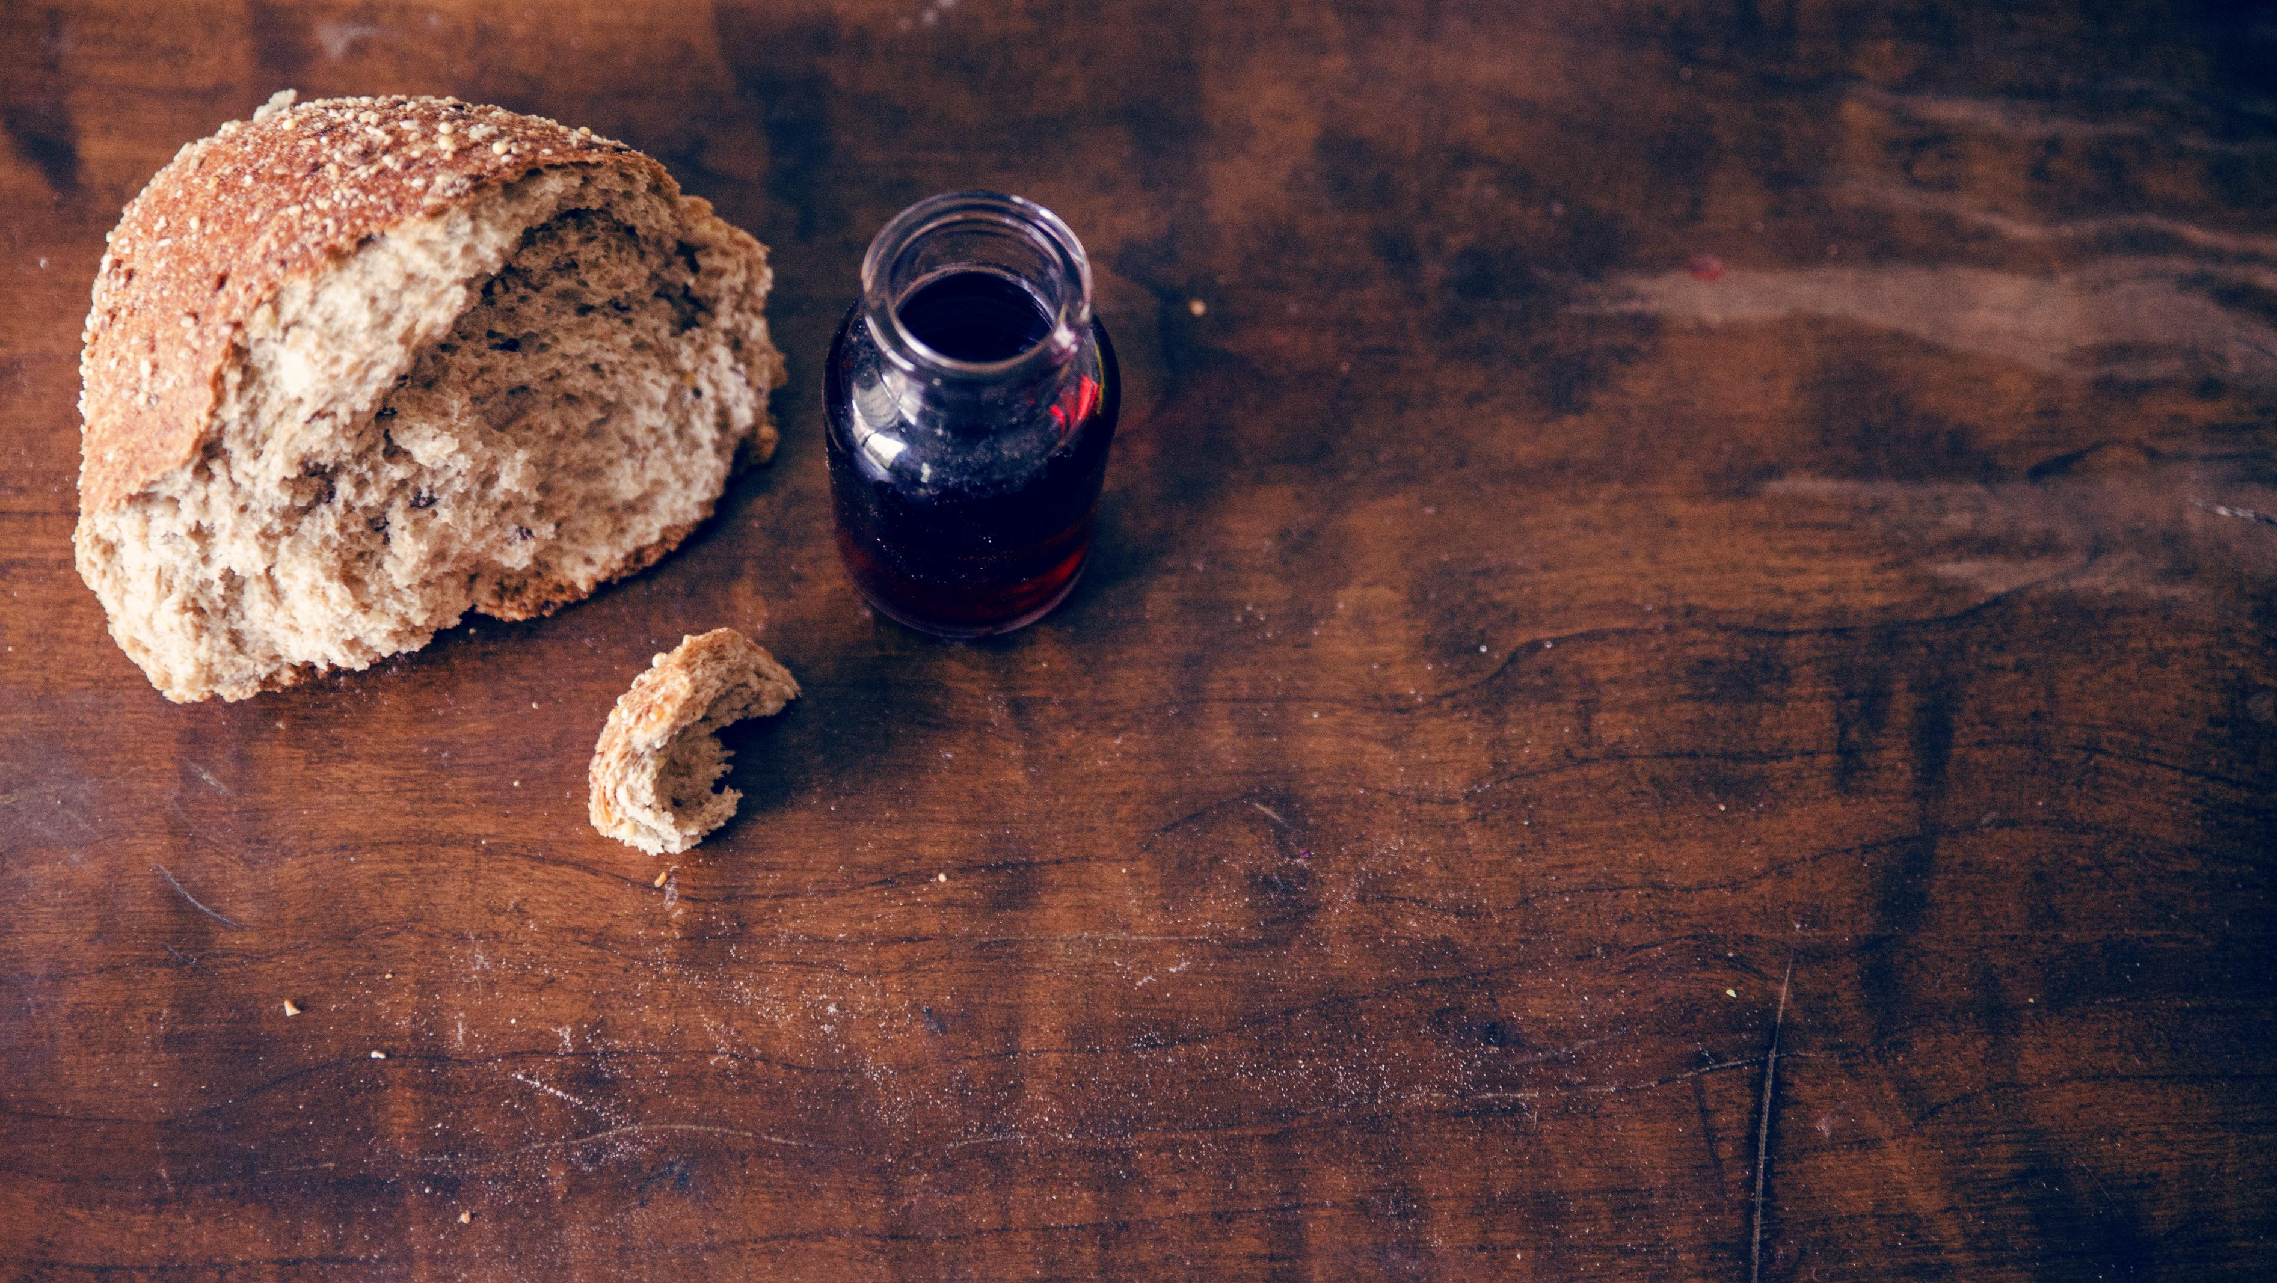
Invitation to the Table
Gayle Flannery & Ron Reed

Slide 29
Offering Meditation Brad Gee
Those who want to save all they have will lose everything, while those who give
all they are for the sake of Jesus Christ, will gain eternal blessing.

Slide 30
Offering Meditation Brad Gee
Come, bring what you have and offer it to God, that the poor will have food in abundance,
and all may know God’s love.

Slide 32
Doxology
Praise God, from whom all blessings flow; Praise Him, all Creatures here below; Praise Him above, ye heav’nly host; Praise Father, Son, and Holy Ghost!

Slide 33
Prayer of Dedication Brad Gee
Creator of all things, we give back to you in praise of your glory.

Slide 34
Prayer of Dedication Brad Gee
We do not wish to simply praise you with our song and our words and our hands;

Slide 35
Prayer of Dedication Brad Gee
We wish to praise you by loving our brothers and sisters in Christ. Take and use our gifts, that they may serve your kingdom. AMEN

Slide 36
Brad Gee ^{Scripture} ^{Psalm 96:1-10}
1 Sing to the Lord a new song; sing to the Lord, all the earth.
2 Sing to the Lord, praise his name; proclaim his salvation day after day.

Slide 37
3 Declare his glory among the nations, his marvelous deeds among all peoples. 4 For great is the Lord and most worthy of praise; he is to be feared above all gods.

Slide 38
5 For all the gods of the nations are idols, but the Lord made the heavens. 6 Splendor and majesty are before him; strength and glory are in his sanctuary.

Slide 39
7 Ascribe to the Lord, all you families of nations, ascribe to the Lord glory and strength. 8 Ascribe to the Lord the glory due his name; bring an offering and come into his courts.

Slide 40
9 Worship the Lord in the splendor of his holiness; tremble before him, all the earth. 10 Say among the nations, “The Lord reigns.” Psalm 96:1-10

Slide 42
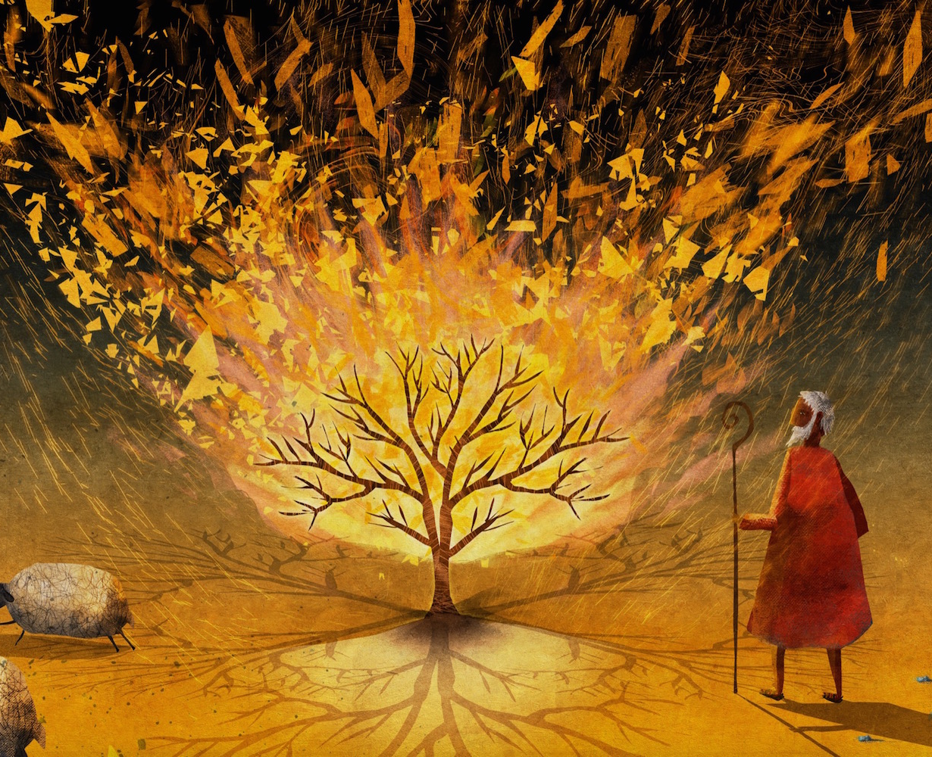
^{Evan Snyder & Chris Fluitt} ^{“Worship: Glory, Beauty, Holy"}

Slide 43
Glorious Beautiful & Holy (Change Everything)

Slide 44
Moses walked through a wilderness with regret & past mistakes
But then he saw Your holy fire, that changed everything

Slide 45
Glorious, Beautiful, Holy,
that is who you are
Lord to see you on display, that’s my heart’s desire
Come change everything

Slide 46
I walk through a wilderness with regret and shame
But then I hear Your voice so clear, calling me by name

Slide 47
Glorious, Beautiful, Holy,
that is who you are
Lord to see you on display, that’s my heart’s desire
Come change everything

Slide 48
Make me full of Your glory
Fill me with all of Your beauty
Change me, Lord make me holy like you

Slide 49
Make me full of Your glory
Fill me with all of Your beauty
Change me, Lord make me holy like you

Slide 50
Glorious, Beautiful, Holy,
that is who you are
Lord to see you on display, that’s my heart’s desire
Come change everything

Slide 51
You change everything

Slide 52
Glorious, Beautiful, Holy,
that is who you are

Slide 53
^{Hymn of} ^{Invitation} ^{p391} ^{vs 1,2,4}
Savior Like A Shepherd Lead Us

Slide 54
Savior, like a shepherd lead us,
Much we need Thy tender care;
In Thy pleasant pastures feed us,
For our use Thy folds prepare:

Slide 55
Blessed Jesus, blessed Jesus, thou hast bought us, Thine we are;
Blessed Jesus, blessed Jesus, thou hast bought us, Thine we are.

Slide 56
We are Thine, do Thou befriend us,
be the guardian of our way;
Keep Thy flock, from sin defend us,
Seek us when we go astray:

Slide 57
Blessed Jesus, blessed Jesus, Hear, O hear us when we pray;
Blessed Jesus, blessed Jesus, Hear, O hear us when we pray;

Slide 58
Early let us seek Thy favor,
Early let us do Thy will;
Blessed Lord and only Savior,
With Thy love our bosoms fill:

Slide 59
Blessed Jesus, blessed Jesus, Hear, Thou hast loved us, love us still;
Blessed Jesus, blessed Jesus, Thou hast loved us, love us still;

Slide 60
Benediction Gayle Flanery

Slide 61


